Slide 1
Python Sequences
Dictionary
Session 4b

Slide 2
Objectives
Dictionary manipulation
Dictionary methods

Slide 3
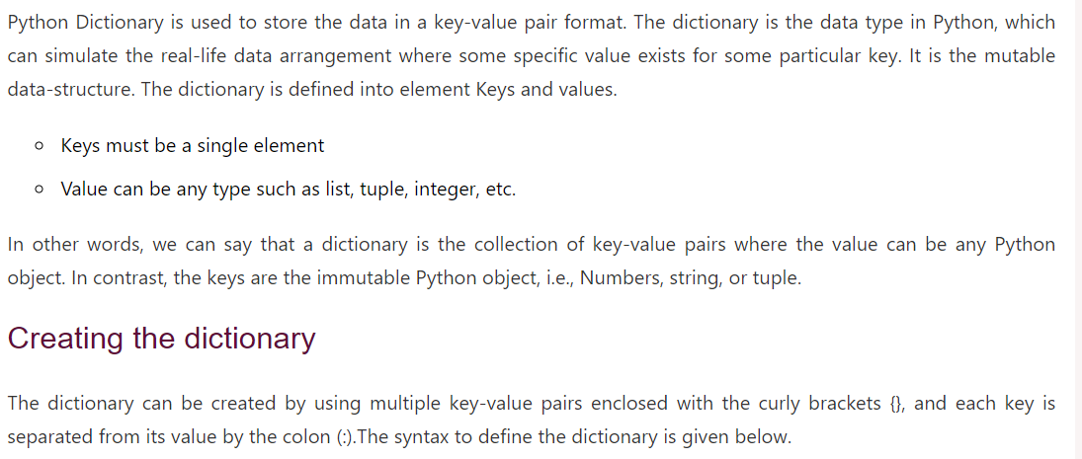
Python Dictionary

Slide 4
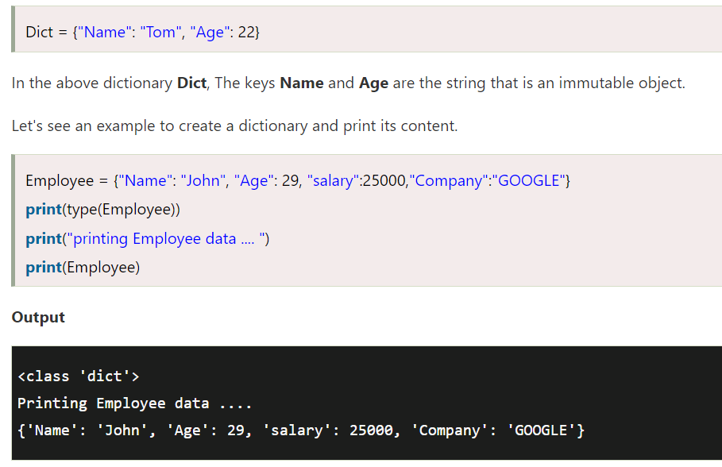
Python Dictionary

Slide 5


Python Dictionary
Accessing Values in Dictionary
  To access dictionary elements, you can use the familiar square brackets along with the key to obtain its value. Following is a simple example −
  When the above code is executed, it produces the following result −

Slide 6

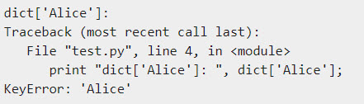
Python Dictionary
If we attempt to access a data item with a key, which is not part of the dictionary, we get an error as follows
When the above code is executed, it produces the following result

Slide 7
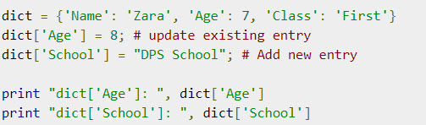

Python Dictionary
Updating Dictionary
  You can update a dictionary by adding a new entry or a key-value pair, modifying an existing entry, or deleting an existing entry as shown below in the simple example
  When the above code is executed, it produces the following result

Slide 8
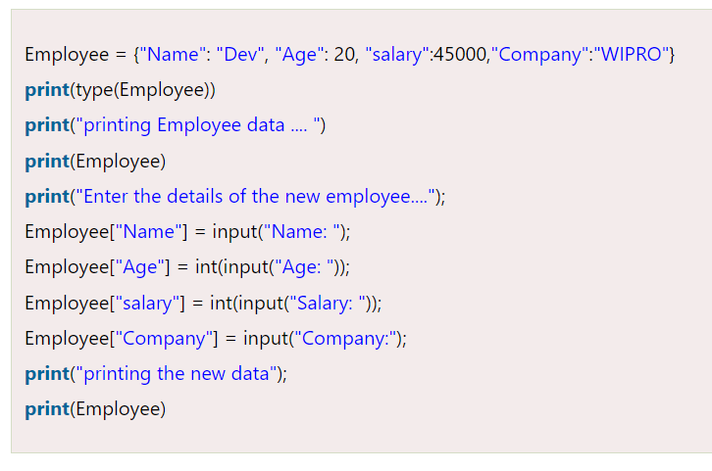
Python Dictionary

Slide 9
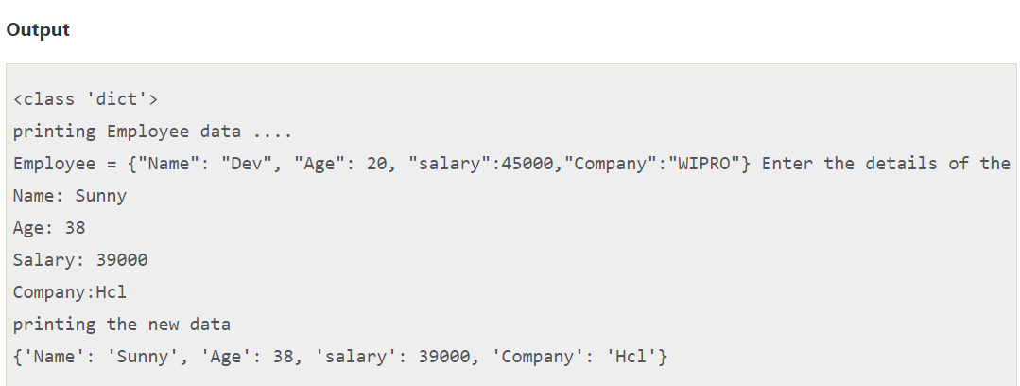
Python Dictionary

Slide 10
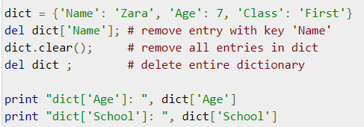
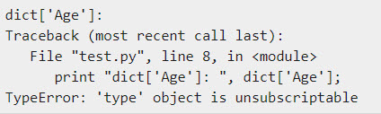
Python Dictionary
Delete Dictionary Elements
  You can either remove individual dictionary elements or clear the entire contents of a dictionary. You can also delete entire dictionary in a single operation.
  To explicitly remove an entire dictionary, just use the del statement. Following is a simple example
  This produces the following result. Note that an exception is raised because after del dict dictionary does not exist any more

Slide 11

Properties of Dictionary Keys
Dictionary values have no restrictions. They can be any arbitrary Python object, either standard objects or user-defined objects. However, same is not true for the keys.
There are two important points to remember about dictionary keys −
  (a) More than one entry per key not allowed. Which means no duplicate key is allowed. When duplicate keys encountered during assignment, the last assignment wins. For example −
  When the above code is executed, it produces the following result

Slide 12


Properties of Dictionary Keys
b) Keys must be immutable. Which means you can use strings, numbers or tuples as dictionary keys but something like ['key'] is not allowed. Following is a simple example
When the above code is executed, it produces the following result

Slide 13
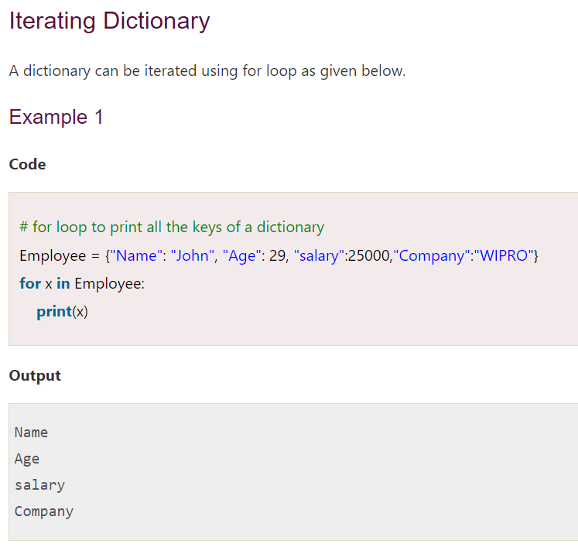
Iteration of Dictionary

Slide 14
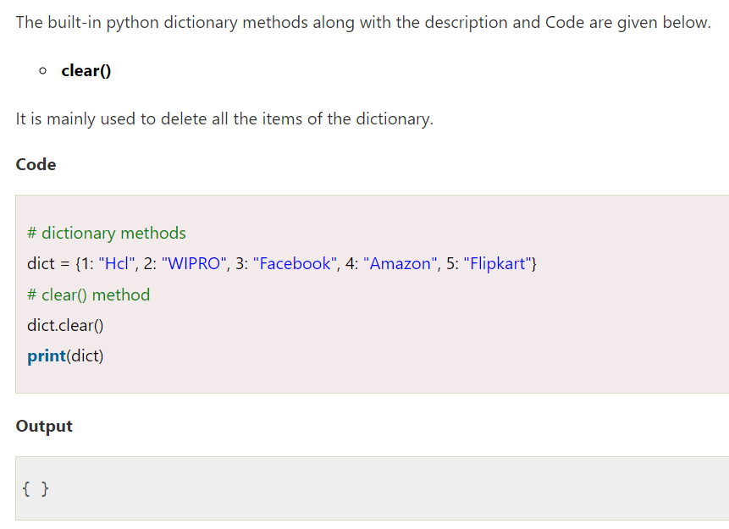
Built-in Dictionary Methods

Slide 15
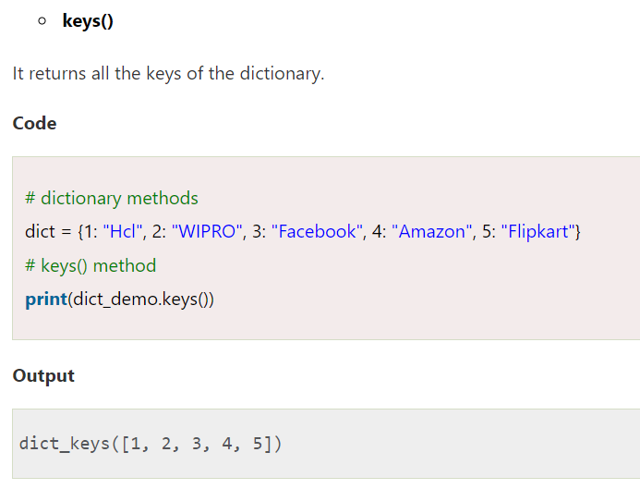
Built-in Dictionary Methods

Slide 16
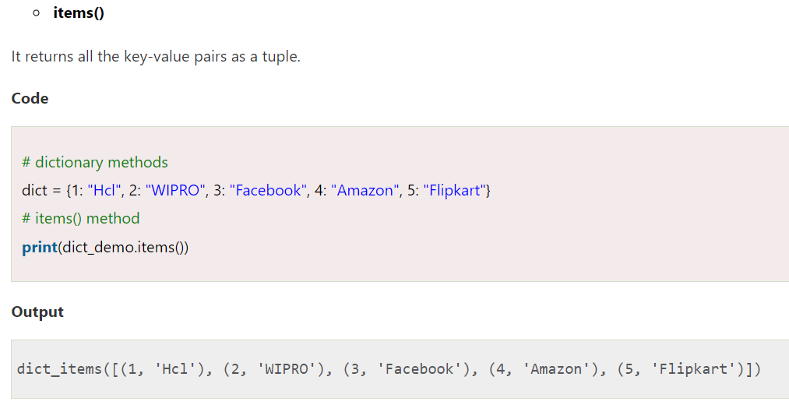
Built-in Dictionary Methods

Slide 17
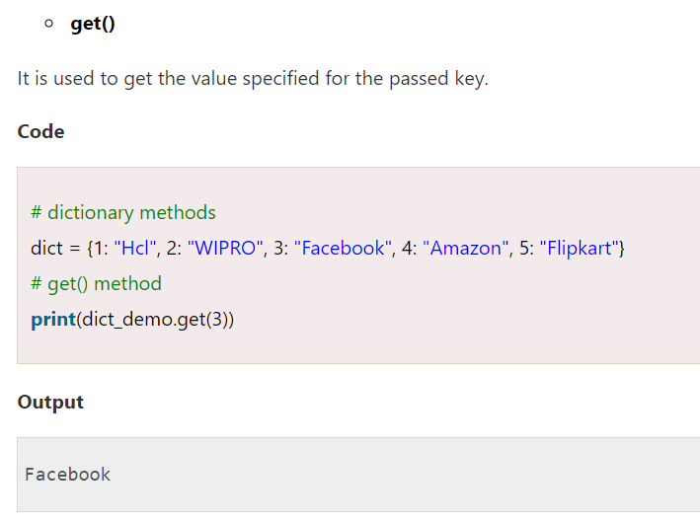
Built-in Dictionary Methods

Slide 18
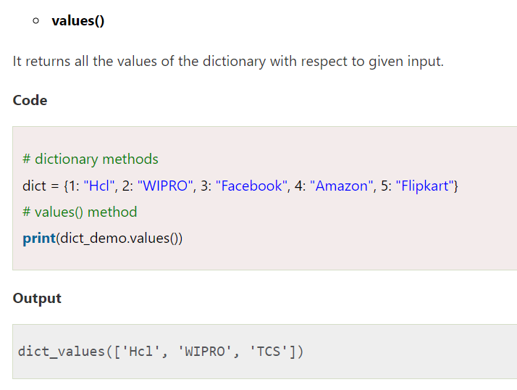
Built-in Dictionary Methods

Slide 19
Summary
Dictionary manipulation
Dictionary methods

